Slide 1
Layers of Cerebral Cortex
Dr Reshmy K.R
Professor
Dept of Physiology
SKHMC

Slide 2
Phylogenetical division of Cerebral cortex
Neocortex
The major portion of the cerebral cortex.
The top layer of the cerebral hemisphere 2-4mm thick
Have 6 layers labelled I to VI( VI being the innermost and I being the outer most
10-14 billion neurons
Allocortex
Phylogenetically oldest area
Remaining part of the cerebral cortex
Less than 6 layers
It includes Archicortex and Paleocortex that forms part of the limbic system

Slide 3
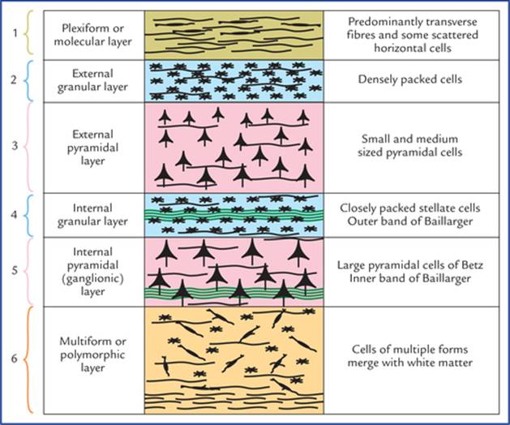

Slide 4
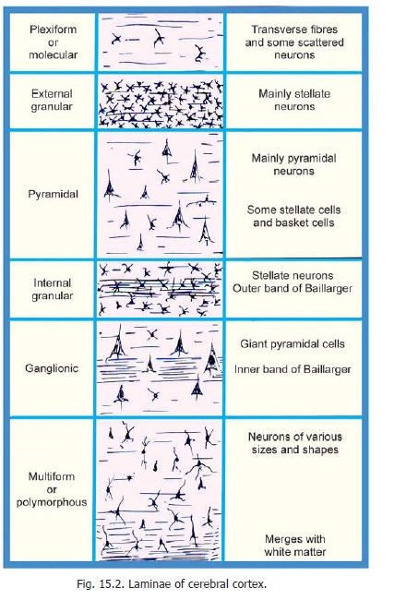
Histological structure
Cells
1. Pyramidal cells( 2/3rd )
2.Stellate cells or Granule cells(1/3 rd )
3.Fusiform cells

Slide 5
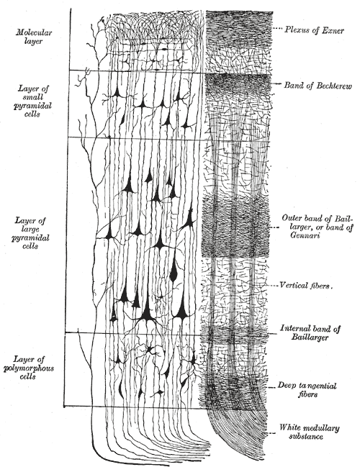
Histological structure
1.Molecular / Plexiform layer
Less no of cells
Small ,pear shaped or fusiform
Apical dendrites or axons from cells of deeper layers
Contains horizontal cells- CAJAL

Slide 6
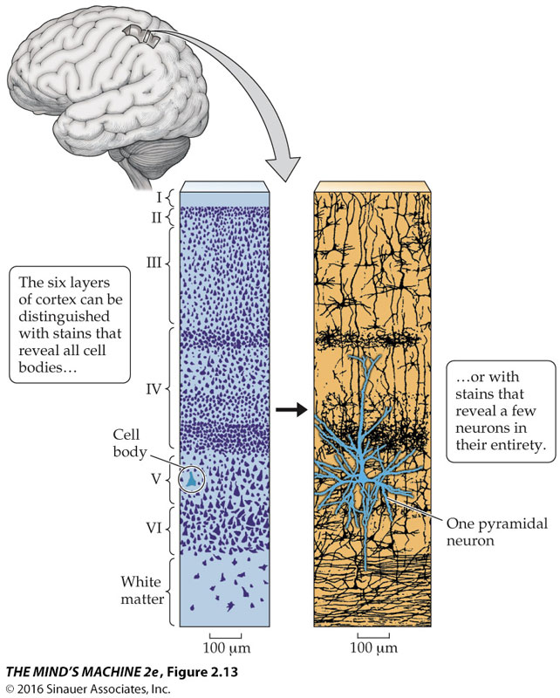
Histological structure
2. External Granular layer
contains large no of small cells
round, polygonal or triangular, closely packed
dendrites -to the molecular layer
Axons-to deeper layers

Slide 7
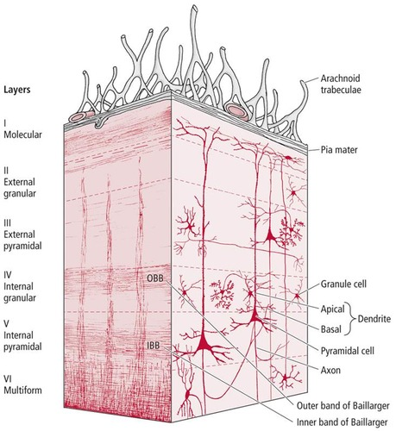
3. Outer Pyramidal Layer
contains pyramidal cells, basket cells
outer portion -medium sized pyramidal cells
deeper portion- larger pyramidol cells

Slide 8
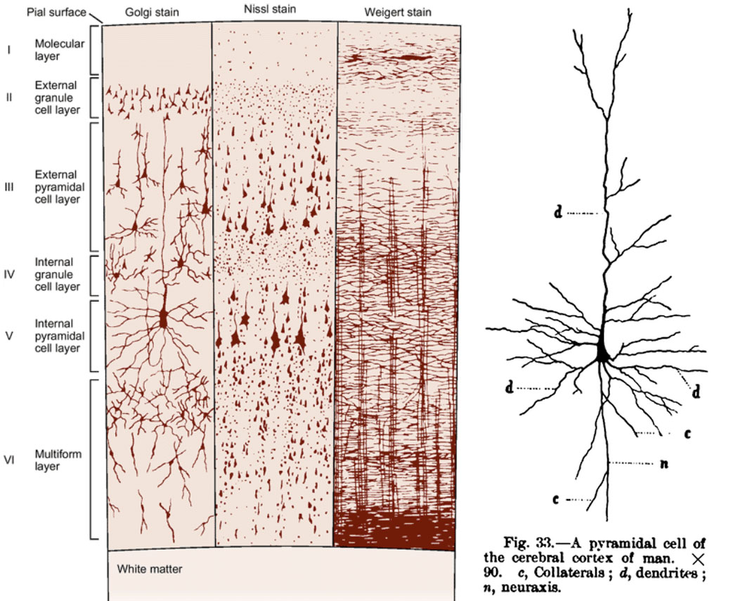
4. Internal Granular layer
Densly packed stellate cells
Nerve fibers are more
Inner zone prominent -transverse fibers- white strip/outer strip

Slide 9
5. Ganglionic/Internal Pyramidal Layer
Large pyramidal cells/Betz/gaint cells
Developed in precentral mortor cortex
Cells of Martinotti-axons pass outwards towards the surface of the cortex

Slide 10
6. Polymorphous/Fusiform cell layer/multiform layer
Modified Pyramidal cells
Many fusiform cells/spindle shaped cells closely packed
Contact with the white matter of cerebral hemispheres

Slide 11
Phylogenetical division of Cerebral Cortex
1.Allocortex - 10% (Limbic cortex)
Archicortex Paleocortex
Hippocampus Dentate Gyrus
parahyppocampal gyrus Uncus
2.Mesocortex
Transitional zone
3. Neocortex/Isocortex
90% of cerebral cortex

Slide 12
Types of Neocortex
Type I/ Granular cortex
Granulae cells / stellate cells absent
Pyramidal cells- large Betz cells
seen in Motor cortex (4) & Brocas area (44)
Type II/ Frontal cortex
Triangular granular cells
seen in frontal lobe

Slide 13
Types of Neocortex
Type III/ Parietal cortex
Depth & density of layer II, III increased
Granulae cells-round
seen in Parietal lobe,junction of parietal, temporal & occipital lobe
Type IV/Polar cortex
cortex narrow
reduced depth in all layers
seen in frontal& occipital pole
Type v granular cortex
Excess granule cells
seen in sensory cortex& calcarine region

Slide 14
Reference
https://epomedicine.com/medical-students/cerebral-cortex-layers-microanatomy-simplified/
https://en.wikipedia.org/wiki/Neocortex
Thank you

